Slide 1

Why Zephyr is becoming a must for Embedded Development

Slide 2



Agenda
Why Zephyr is becoming a must
for Embedded Development
Introduction
Overview of Zephyr RTOS
Configurability, modularity and portability
Security concerns in Zephyr RTOS
Conclusion

Slide 3

What are the challenges when developing MCU Embedded devices?
Portability
Modularity
Development workflow
Security
Connectivity
Notes:
Problem: Plenty of challenges in a very constrained environment (real-time execution, small memories), solutions are historically proposed by each vendor and is fragmented. Reuse of some parts already developed is not straight forward and requires a lot of work to build proper development environment or create an SDK.
Examples: Integrating an RTOS on a specific platform, assembling and configuring the different modules required to the application (drivers, file system, TLS…), integrating bootloader, etc. STMicroelectronics provides STM32CubeMX ecosystem, Espressif provides ESP-IDF framework, etc. So even swapping from a microcontroller to another require changing the development environment and ask developers to constantly adapt themselves.

Slide 4

Overview of Zephyr RTOS
“The Zephyr OS is based on a small-footprint kernel designed for use on resource-constrained and embedded systems”
Multiple architectures (ARM, RISC, Tensilica Xtensa…)
Highly configurable and modular (Kconfig, devicetree)
Many drivers and subsystems (Bluetooth, LLEXT, LoRaWAN, Modbus, shell…)
Many supported boards and examples
Permissive licensing
Notes:
Zephyr: open-source RTOS ecosystem, hosted by Linux Foundation, VERY VERY ACTIVE COMMUNITY (individuals, organizations).
Support many architectures: particularly ARM, RISC, Xtensa, Intel x86…
Configurable and modular: inherit Kconfig and hardware abstraction model using a common API for each class of device, along with devicetree to select the underlying driver to use and configure the device means that application software can be portable across a variety of boards and even architectures without code changes.
Drivers, subsystems: huge range of subsystems and libraries are included in Zephyr and can be selected and configured using Kconfig. Examples: activating the shell in the console with CONFIG_SHELL. Integrating connectivity interfaces (Wi-Fi, …).
Boards and samples: more than 700 boards and shields, samples for each functionality and subsystem to start quickly.
License: permissive, particularly for commercial products (Apache 2.0)
Zephyr is not just an RTOS, it’s an ECOSYSTEM.
At the opposite, two competitors such as FreeRTOS (very light) and ThreadX have not so rich environment.

Slide 5
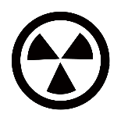



Configurability, modularity and portability
Challenge:
Simplify hardware configuration
Standardization
Kconfig
Device tree
Describe and configure the hardware
Notes:
Challenge: simplify the hardware configuration.
Solution: Use standard tools already available instead of rewriting code for each new project.
Zephyr: propose to use (well known) Kconfig and Device Tree concept.
What you have to do: Describe and configure the hardware (very easy, will check for it soon).
Kconfig and device tree come from Linux build system and greatly simplify hardware and kernel configuration.
Let’s check the details now!

Slide 6

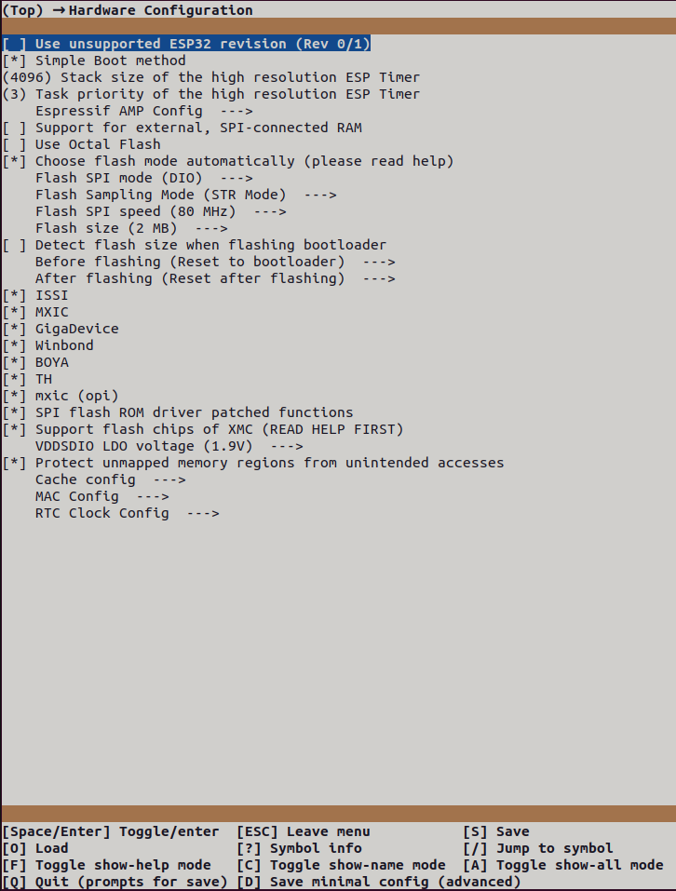

Zephyr provides configuration options using Kconfig
Configuration of kernel features, device drivers and peripherals, integration and configuration of modules and subsystems
Management of dependencies
Application custom configuration entries
Configuration of project using the main configuration file “prj.conf” and the boards/socs configuration files
Notes:
Zephyr: provides Kconfig tools from the Linux kernel to configure the target:
Kernel feature: scheduling options, services…
Device drivers and peripherals: including the wanted drivers and peripherals only if they are required
Modules (external to Zephyr) and Subsystems: Shell, Bluetooth, LoRaWAN, Modbus, Storage, TensorFlow… But also customization for each of them: mbedTLS algorithm and cipher-suites, etc.
Management of dependencies: Kconfig language describes dependencies of the options so if a driver/modules/susbsystem requires another one to be included, it is done automatically. Example: MODBUS, CANOPEN, LWM2M selects CRC. Kconfig language also permit to disable options that will not be supported, for example an option depending of a feature that the microcontroller doesn’t support.
Custom configuration entries: application specific build options managed together with the RTOS options.
menuconfig interface: to navigate and select the options.
Fine tunning permits to integrate exactly what we want and not more.
The configuration of the project is saved in “prj.conf” file. Boards and SOCs specific additions are available as well so that if your project is building different hardware, it is possible to select different options for each of them.

Slide 7
/dts-v1/;
#include <espressif/esp32/esp32.dtsi>
/ {
model = "Espressif ESP32-DevkitC";
compatible = "espressif,esp32";
chosen {
zephyr,console = &uart0;
zephyr,shell-uart = &uart0;
};
};
&uart0 {
status = "okay";
current-speed = <115200>;
};
&uart1 {
status = "okay";
current-speed = <115200>;
modbus0 {
compatible = "zephyr,modbus-serial";
status = "okay";
};
};
Zephyr provides modularity using Device Tree
Describe the configuration of the hardware
Integrate and configure the drivers
Configuration of external modules subsystems
Device tree is translated to configuration and build options; it is not loaded dynamically on the target
Notes:
Zephyr: provides device tree from the Linux kernel to configure the hardware:
Device drivers and peripherals: including the wanted drivers and peripherals only if they are required
Modules (external to Zephyr) and Subsystems: When relevant, associated to nodes of the device tree: Modbus, etc.
The device tree is translated to configuration and build options: It is not loaded dynamically on the target.
Overlay files: permit fine tuning of the hardware in the applications.
Device tree greatly simplify the configuration and the initialization of the hardware. The device tree of a specific board has “dts” extension. It is possible to create include files. Boards and SOCs specific additions are available as well so that if your project is building different hardware, it is possible to customize the device tree for each of them.
Combining drivers with standard APIs allow to make portable applications while the overlays are used to configure hardware variants/versions.
It is mostly vendor agnostic (some few vendor specific options exists).

Slide 8




Security concerns in Zephyr RTOS
Connectivity
Personal data
Backdoor to other systems
Regulatory compliance
Notes:
Increasing connectivity: more connected features, easier to attack REMOTELY (physical access no more required).
Consequences of a Security Breach: devices might handle PERSONAL DATA (e.g., wearables, baby phones…) or control a CRITICAL SYSTEMS (Generally, medical, energy). Example (real!): connected outlets you buy in China.
Regulatory Compliance: Cyber Resilience Act (CRA), manufacturers have greater responsibility for the security of their products.
GOAL is to keep consumer CONFIDENT in the products and GOOD IMAGE of the company.
HISTORICALLY FRAGMENTED, need standardized approach and tools to address security issues.
This is usually not addressed (or not enough) by makers because looks complex (development, manufacturing, organization).

Slide 9
What does security mean for such small devices running an RTOS?
Protection of data and assets
Firmware integrity
Updates
Isolation, memory protection
Selection of hardware and software
Secure communications
Notes:
Problem: Plenty of questions, solutions from Linux development are not applicable as-is. Many tools and concepts from Linux are not back portable.
Example: Isolation is not so clear when all the firmware is just a single binary. How to protect data and processes? How to set privileges?

Slide 10
security features
Zephyr integrates security features as part of the core ecosystem, including, but not limited to:
Bootloader (MCUboot) and firmware update support
Secure communications (networking stack, mbedTLS)
User mode and memory protection
Integration of TrustedFirmware-M (TF-M) for advanced security concerns (isolation, crypto, storage, …)
Notes:
Bootloader and firmware update: Zephyr provides a reference bootloader based on MCUboot:
Device tree: configure memory slots (description of the hardware).
Kconfig: configure bootloader options: SIGNATURE KEY file to be used (default available in MCUboot), UPDATE STRATEGY scratch/swap, support for SERIAL OR USB DFU, disable firmware DOWNGRADE, etc.
It’s almost ready to be used! Just build it, you will get your applications properly configured and signed, and the bootloader binary to flash on the target.
Communications: integration of mbedTLS as a standard solution to create secure sockets:
Register security assets: certificates, private keys, pre-shared keys (PSK) with their IDs
Configure socket: select protocol and set socket option to use security assets.
It’s almost ready to be used! Converting non-secure to secure sockets is really SIMPLIFIED. You may want then to tweak the TLS options (Kconfig).
Kernel feature: Zephyr provides:
User mode: to configure privileges of the threads
Memory protection mechanism: permitting to setup different regions and domains with specific attributes
Stack protection
…
Zephyr also provides an integration of TrustedFirmware-M, with simplified configuration based on Kconfig and device tree, and samples.

Slide 11
Zephyr cares of vulnerabilities
Report at: vulnerabilities@zephyrproject.org
List at: https://docs.zephyrproject.org/latest/security/vulnerabilities.html
Makers are eligible to access vulnerabilities before they are public: https://www.zephyrproject.org/vulnerability-registry
Zephyr creates Software Bill Of Materials (SBOM) of your application (SPDX format)
Vulnerabili-ties
Notes:
Zephyr: has vulnerability tracking.
Email to report them
Early access to the new vulnerabilities when they are reported.
Fixes.
The key element to track vulnerabilities is Software Bill Of Material (SBOM).
Zephyr: provides a specific west command to produce SBOM reports after the build (SPDX format, a standard that is compatible with several VULNERABILITY MANAGEMENT TOOLS).

Slide 12
Security standards enabler
Zephyr cares of security standards
ETSI 303-645, cybersecurity baseline requirements
PSA Certified since Zephyr 2.0.0 with TF-M 1.0, and is currently integrated with TF-M 2.1.0
Zephyr provides Long-Term Support (LTS)
Published every 2 years with 5 years support
Zephyr 3.7 was released on 2024-07-26 and will be End Of Life (EOL) on 2029-07-27
Notes:
Zephyr: cares of security standards
This allow makers to create secure products
Particularly, PSA Certification helps to streamline the process of ACHIEVING CERTIFICATION AT A DEVICE LEVEL.
Zephyr also provides Long-Term support:
A new LTS every 2 years, supporting during 5 years
Security patches backported to the LTS branches

Slide 13
Conclusion
Zephyr provides a rich, modular and highly customizable ecosystem
Zephyr provides production-ready features and components to develop secure devices (kernel features, network stack, bootloader, Trusted Firmware-M, …)
Zephyr announces to continue prioritizing security in the 2025 roadmap
At Witekio we are convinced Zephyr is perfect choice to develop secure devices for industrial applications
Notes:
At Witekio we are convinced ZEPHYR IS PRODUCTION READY SOLUTION, not only because it provides a large ecosystem with a ton of features, drivers, etc., modular and robust architecture, and documentation. But also, thanks to the INTEGRATION OF SECURITY TOOLS. This allows to reduce the complexity and vulnerability of the systems being developed. MAKERS CAN FOCUS ON THEIR MARKET AND SPECIFIC EXPERTISE, instead of losing some time on the integration of such features.
There are pros and cons. As for all the RTOS, it increases complexity and debugging, particularly when dealing with real-time response, opposed to bare-metal solution. However, compared to the main competitors, such as FreeRTOS and ThreadX, Zephyr tackle the main challenges developers always face and help to build better product, faster.

Slide 14
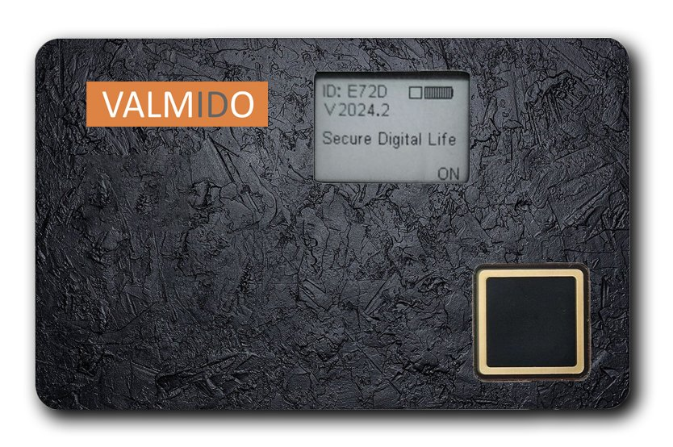
Case study
Valmido authentication smartcard
Fingerprint sensor, secure element, MCU, antenna, e-ink screen and battery in a credit-card-sized form factor running Zephyr RTOS
Integration of FIDO2 (Fast IDentity Online) authentication standard over Bluetooth Low-Energy

Slide 15
Thanks for your attention!

Slide 16




QUIZ
On which architecture(s) Zephyr has been ported?
Some architectures nobody knowns and uses
ARM only, this is already enough to cover most hardware
RISC and Xtensa because this is an initiative of the “Espressif foundation”
All of theses, and much more!

Slide 17
QUIZ
What is the name of the hardware description tool, which uses a hierarchical node syntax, borrowed from the Linux kernel?
This concept is not part of Zephyr: you must start from scratch every time, and there's no portability
Device tree
Kconfig
mcuboot

Slide 18
QUIZ
How long an LTS version of Zephyr is supported?
There is no LTS support
2 years
5 years
10 years

