Slide 1


Twister 101: Practical Tips and Best Practices
Maciej Perkowski
© Nordic Semiconductor

Slide 2
Outlook:
Why Twister?
Basics
  CLI flags
  Test yaml details
  Supported harnesses
Run hardware tests
  Hardware maps
  Fixtures
Test plans
Pytest plugin

Slide 3
Why Twister?
Testing framework (in python) dedicated for Zephyr.
Detects tests,
Some autonomy in scope selection,
Build and/or execute
Reports with results
Supports:
Emulators (e.g. QEMUs, Renode),
Simulators (e.g. native_sim),
Hardware,
Monitoring memory footprints,
Gcov+Lcov for coverage,
Valgrind/Asan/UBSan for dynamic analysis,
Use cases:
On desk development
PR verification
Vendors testing on “board farms”

Slide 4
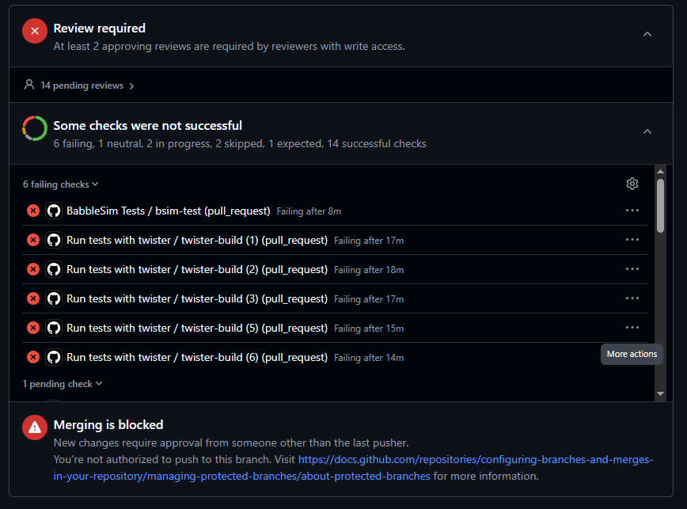

Slide 5
Basics :
Executable script: zephyr/scripts/twister
Test scope:
  --testsuite-root (-T) [path]
  --scenario(-s/--test) (also useful --no-detailed-test-id)
  --load-tests(-F)
  --quarantine-list [quarantine_file]
Platform scope:
  Nothing (default platforms)
  --platform(-p) [platform_name]
  --arch(-a) [arch_name]
  --integration(-G)
https://docs.zephyrproject.org/latest/develop/test/twister.html

Slide 6
Basics :
Executable script: zephyr/scripts/twister
Customize output:
  --verbose(-v)
  --log-level [DEBUG, INFO, CRITICAL, etc]
  --outdir (-O), --report-dir(-o) [path]
  --clobber-output(-c) / --no-clean
  --runtime-artifact-cleanup(-M)
Customize build/run options:
  --extra-args(-x)
  --build-only(-b) / --test-only
  --retry-failed [#]
  $ZEPHYR_TOOLCHAIN_VARIANT
  $XXX_TOOLCHAIN_PATH
https://docs.zephyrproject.org/latest/develop/test/twister.html

Slide 7
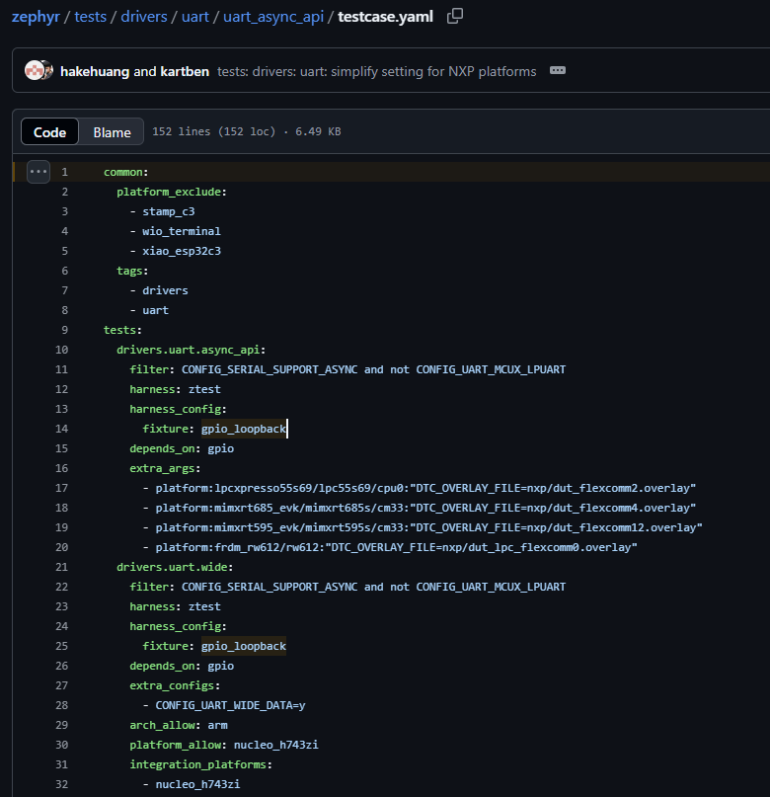
Test yaml
Section used by all scenarios.
Can be tricky: overwrite or append?
Scenarios. Individual builds.
Static filters. String matching.
Extra arguments used during building.
Runtime filters. Require (simplified) cmake step.
Integration_platforms: Minimal set of platforms where the scenario must be verified in integration (--integration(-G)) mode

Slide 8
Available harnesses:
Console: common in samples. Look for a specified output
Ztest (ctest, gtest): use ztest (c-,g-) framework in build. Adds asserts etc. to the app. App reports the results and Twister parse them
Pytest: After building a configuration pass the execution to pytest. Parse pytest results.
Robot: Like pytest but with Robot framework
Shell: Wrapper over pytest test using shell fixture, where input/ required output are taken from the test yaml.
Other (e.g. bluetooth, keyboard): Twister skips execution on those. Used to marked missing functionality. Not “tests” in most cases.

Slide 9
On-target tests (hardware)
- available: true
connected: true
fixtures:
- gpio_loopback
- gpio_spi_loopback
- adc_ref_volt
- external_flash
id: '683205364'
platform: nrf52840dk/nrf52840
product: J-Link
runner: nrfutil
serial: /dev/serial/by-id/usb_J-Link_0006364-if00
- available: true
connected: true
fixtures: []
id: '1050221422'
platform: nrf52840dk/nrf52840
product: J-Link
runner: nrfutil
serial: /dev/serial/by-id/usb_J-Link_0012212-if00
--device-testing
--device-serial [port]
--device-serial-pty [script]
--hardware-map [hwmap]
--generate-hardware-map [hwmap]
  Requires manual input:
  platform
  (runner)
  (fixture)
HW map should be regenerated before each run

Slide 10
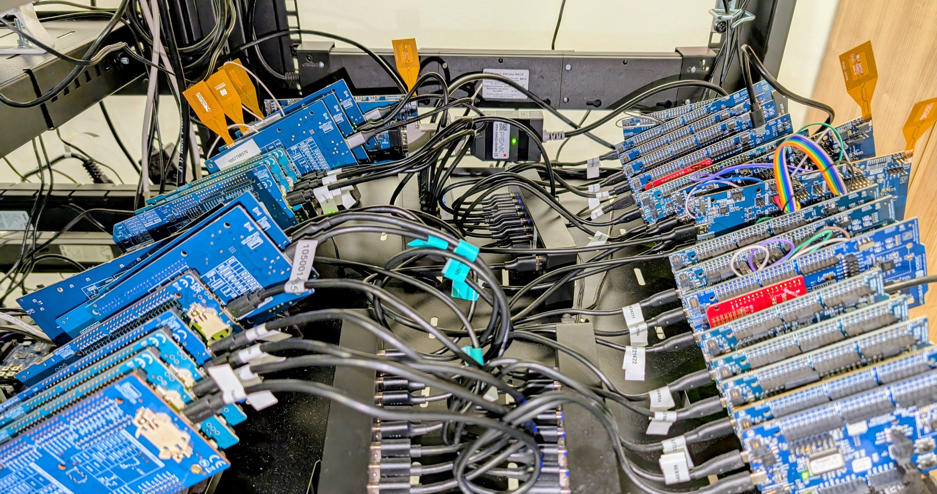

Slide 11
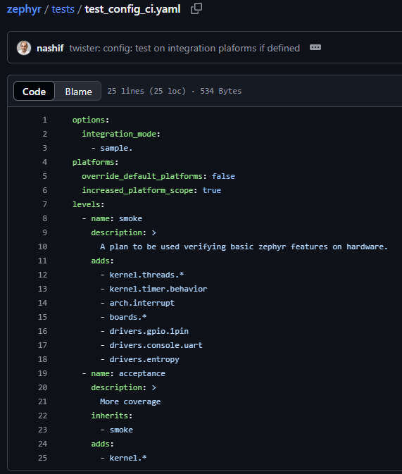
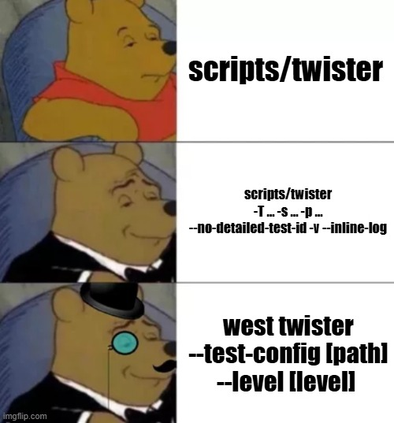
Test plan
scripts/twister
scripts/twister -T … -p … --no-detailed-test-id
-v --inline-logs
scripts/twister
--test-config [path]
--level [level]

Slide 12
scripts/ci/ test_plan.py
Dynamic testing scope based on files changed in git scope
Great for CI runs on-PRs
Workflows:
  Module (in west manifest): Add tests from this module
  File in a directory with test yaml: -T [this_directory]
  Files in a board directory: -p [this_board]
  Adds tests with tags linked with modified folders
Output test plan file can be loaded with --load-tests

Slide 13
Benefits of pytest
  Use existing python libraries in a test (e.g. REST API)
  Communicat with DUT during the test (e.g. shell-based applications)
  Setup on the host side (e.g. connecting with a server)
  Enable additional tooling (e.g. a CLI-based tool, like MCUmgr or CAN interface)
  Use more than a single device (e.g. two devices talking to each other over Bluetooth)
https://docs.zephyrproject.org/latest/develop/test/pytest.html
https://youtu.be/6PJ9BnukwoA

Slide 14
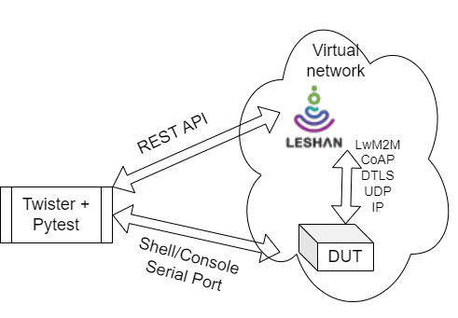
Example: end2end tests
LwM2M Interoperability tests using Leshan demo server (tests/netlib/lwm2m/interopt)
def test_LightweightM2M_1_1_int_102(shell: Shell, dut: DeviceAdapter, leshan: Leshan, endpoint: str):
"""LightweightM2M-1.1-int-102 - Registration Update"""
lines = shell.get_filtered_output(shell.exec_command('lwm2m read 1/0/1 -u32'))
lifetime = int(lines[0])
lifetime = lifetime + 10
start_time = time.time() * 1000
leshan.write(endpoint, '1/0/1', lifetime)
dut.readlines_until(regex='.*net_lwm2m_rd_client: Update Done', timeout=5.0)
latest = leshan.get(f'/clients/{endpoint}')
assert latest["lastUpdate"] > start_time
assert latest["lastUpdate"] <= time.time()*1000
assert latest["lifetime"] == lifetime
shell.exec_command('lwm2m write 1/0/1 -u32 86400')
Based on Open Mobile Alliance specification
Requires extra tools and environment configuration (docker image provided)
full end2end

Slide 15
Summary
Twister:
  Test framework made for Zephyr tests
  Useful for automation
  Dozens of features
  Can be used with board farms (hardware map)
  Support for test plan creation
Harnesses
    parse consol output directly
    pass execution to subprocess (e.g. python) and parse their results
    Ztest: low level / unit tests
    pytest: high level / system

