Slide 1


Getting Started with Zephyr on NXP MCX microcontrollers
GDL Systems Engineering
Missael Maciel

Slide 2

What is Zephyr?
Zephyr is a small RTOS for connected, resource-constrained and embedded devices supporting multiple architectures released under the Apache License 2.0.
Zephyr includes:
Kernel
Libraries
Device Drivers
Protocol Stacks
File systems
Firmware updates
Zephyrus is the ancient greek god of the “West Wind”

Slide 3

What is Zephyr?
1. Vendor/IDE Independent Software Build / Construction System
6. Documentation and Automated Test Framework
2. Platform Independent RTOS Scheduler, Synchronization, Memory Management, etc.
5. Open Development Community Model
3. Hardware Driver/Interface Model (SPI, I2C, UART , Network, etc.)
4. Common APIs, Useful Utilities and Functions

Slide 4
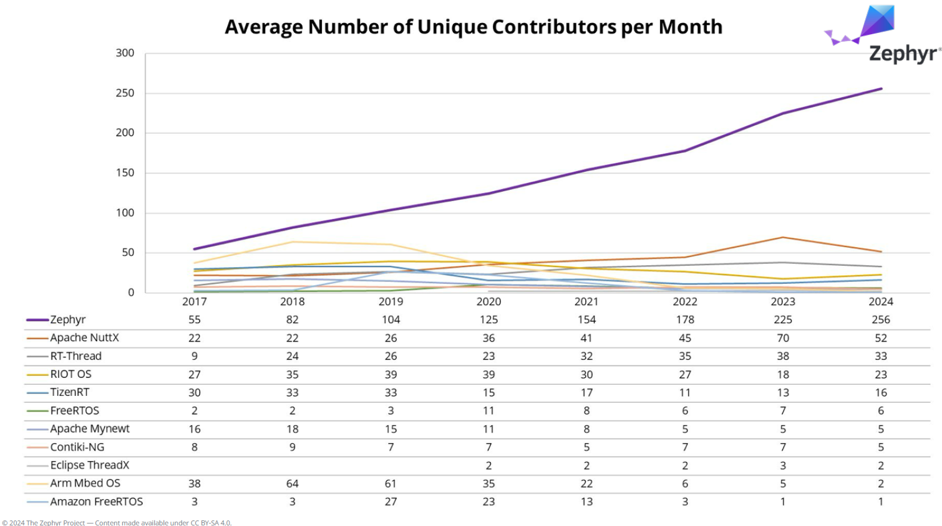
Zephyr Support Scale

Slide 5
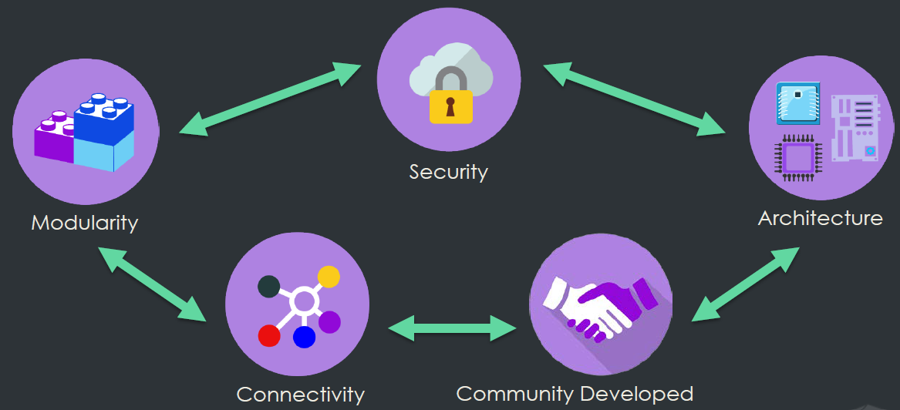
Zephyr Project Features

Slide 6
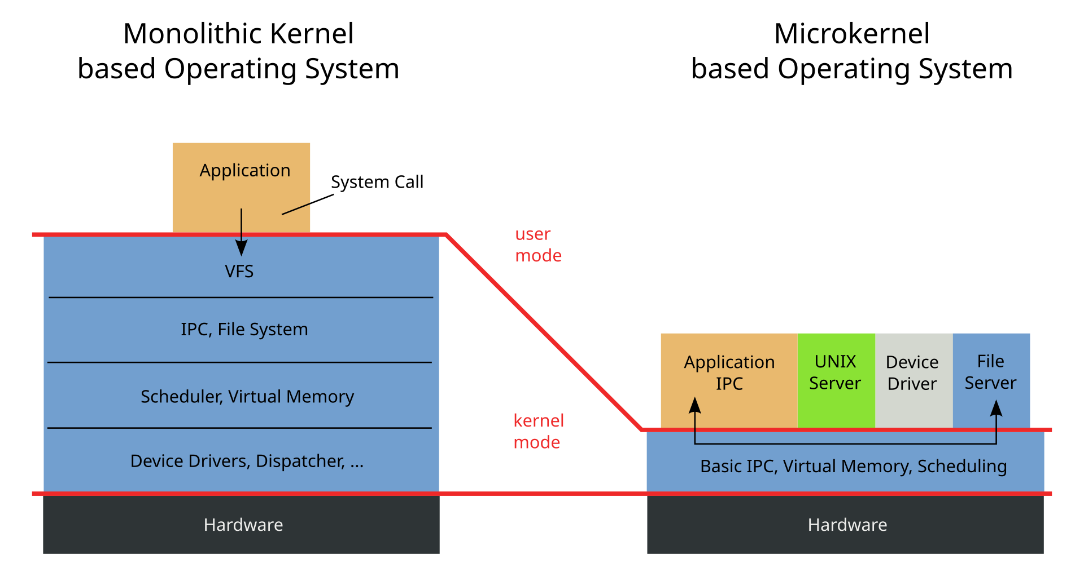
Zephyr’s Architecture Overview
Early Zephyr kernel used nanokernel/microkernel architectures
In 2016, with the release 1.6, Zephyr changes to a monolithic kernel architecture

Slide 7
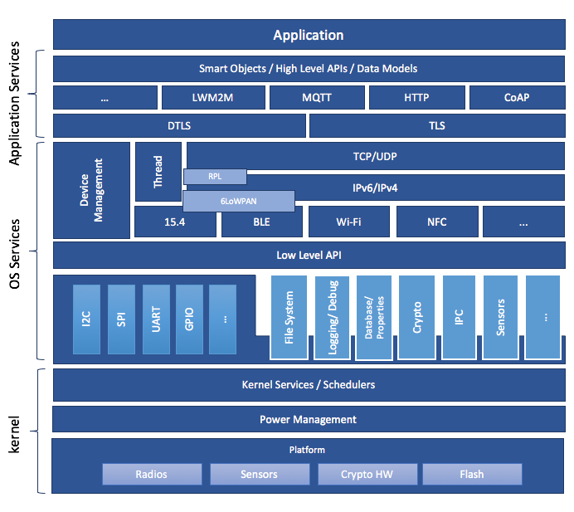
Zephyr’s Monolithic Architecture

Slide 8
Zephyr’s Architecture Overview
Zephyr is a full-featured OS with an architecture that allows developers to focus on the application.
Highly configurable and modular.
Supports cooperative and preemptive threading.
Memory and resources are typically statically allocated, benefitting long-running systems.
An integrated device driver interface.
Offers memory protection via stack overflow protection, kernel object and device driver permission tracking, and thread isolation.
Bluetooth® Low Energy (BLE 4.2, 5.0) support, with both controller and host, BLE Mesh.
802.15.4 OpenThread compliant.
A native, fully featured and optimized networking stack.
Supports a range of subsystems, including USB, filesystem, logging, DFU (Device Firmware Upgrade).

Slide 9
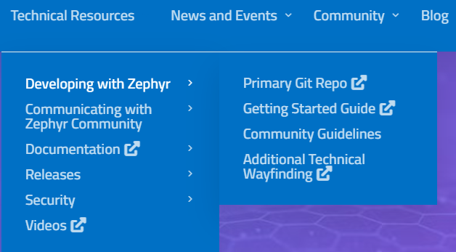
Zephyr’s Official Documentation
Official documentation is hosted in the Zephy’r Project wiki page:
https://www.zephyrproject.org
Official documentation mainly includes:
Primary Git Repo: Official project’s source code hosted in GitHub.
Getting started guide: For Linux/MAC/Windows build environment.
Documentation: Architecture, Kernel, OS services and APIs.
Collateral: Trainings, demos and examples.

Slide 10
Zephyr’s Official Documentation
Getting started guide for:
Set up a command-line Zephyr development environment on Ubuntu, macOS, or Windows.
Get the source code.
Build, flash, and run a sample application.
This guide does not cover anything about application development, this is just to environtment setup.
Learning how to develop applications, zephyr structures, API’s usage and OS services is spread through all documentation and could be difficult to follow from scrach.

Slide 11
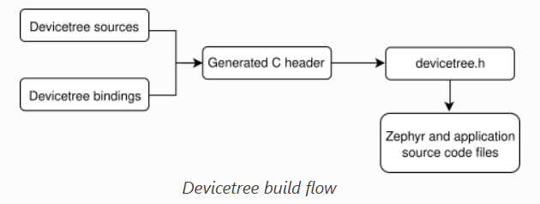
Zephyr Hardware Abstraction
One of the key features on the Zephyr’s environment is how the Hardware is described and abstracted.
Zephyr uses the Devicetree Specification for:
Abstract all the HW available in its “Supported Boards”.
Hardware’s initial configuration.
Then, Devicetree is both a hardware description language and a configuration language for Zephy

Slide 12
Zephyr Hardware Abstraction
Devicetree Specification is a hierarchical structure that defines the platform as nodes and subnodes.
Main node
soc {
porta: pinmux@40049000 {
compatible = "nxp,port-pinmux";
reg = <0x40049000 0xd0>;
clocks = <&sim KINETIS_SIM_BUS_CLK 0x1038 9>;
};
adc0: adc@4003b000{
compatible = "nxp,kinetis-adc16";
reg = <0x4003b000 0x70>;
interrupts = <15 0>;
status = "disabled";
#io-channel-cells = <1>;
};
};
Subnode

Slide 13
Zephyr Hardware Abstraction
Zephyr environment normally uses two levels of Hardware abstractions (Devicetree source files).
SOC Abstraction
Board Abstraction
CPUs
Memory
PowerModes
Clocks
Peripherals
Interfaces
LEDs
Buttons (keys)
External HW
Labels/Aliases for Application

Slide 14
NXP MCUXpresso for Visual Studio Code
01
For Zephyr Development

Slide 15
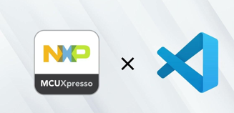
NXP MCUXPresso for Visual Studio Code
NXP provides a plugin for the VSC enviroment that helps developers to speedup
the getting started and development process with Zephyr.
MCUXPresso pluging for VSC provides:
Easy Zephyr environment setup.
Clone official or private Zephyr repository.
Import and configure Zephyr examples and/or projects.
Devicetree explorer.
Build, Flash and Debug.
Use VSC as Project explorer and code editor.

Slide 16
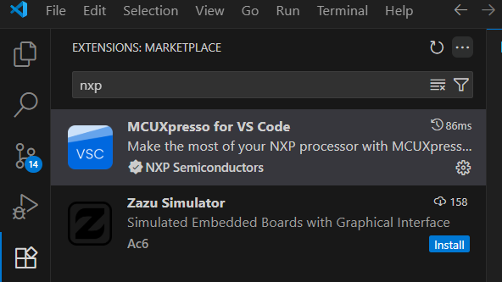
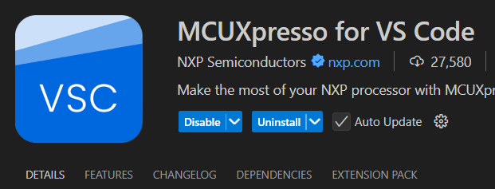
NXP MCUXPresso for Visual Studio Code
You can get MCUXPresso plugin from VSC extensions installer
Extensions installer

Slide 17
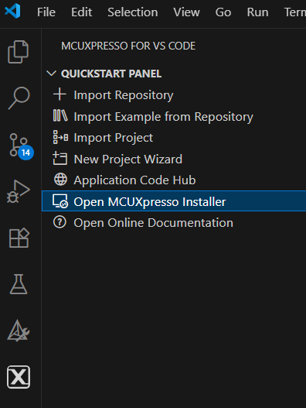
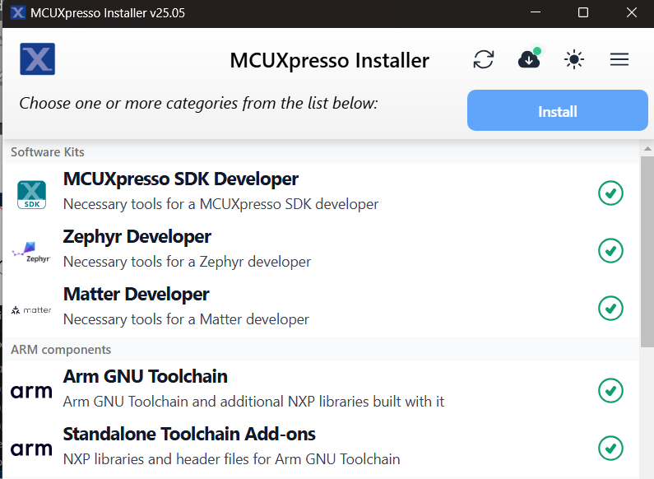
NXP MCUXPresso for Visual Studio Code
Zephyr environment Setup using MCUXPresso Installer

Slide 18
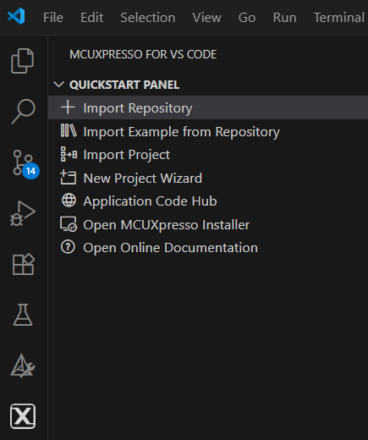
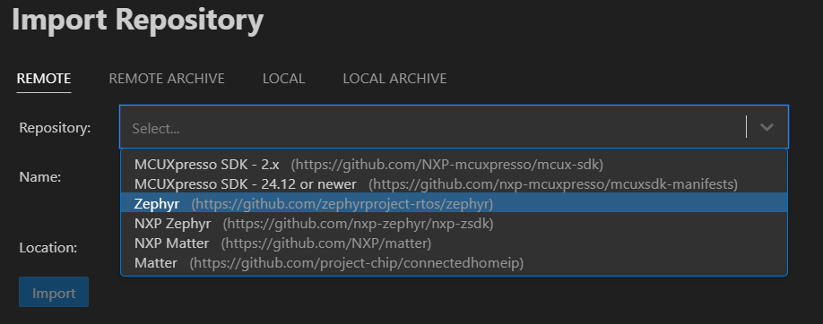
NXP MCUXPresso for Visual Studio Code
Clonning Zephyr official Repository

Slide 19
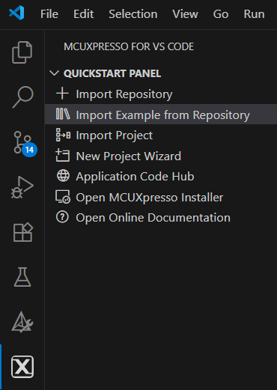
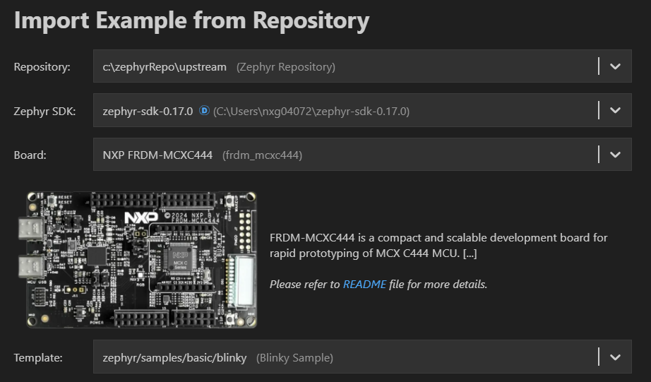
NXP MCUXPresso for Visual Studio Code
Import Zephyr example

Slide 20
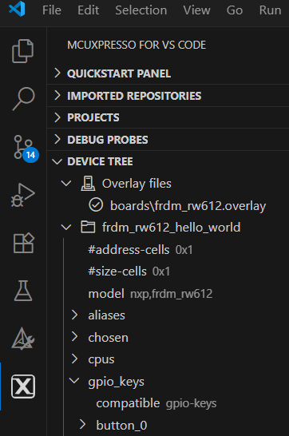
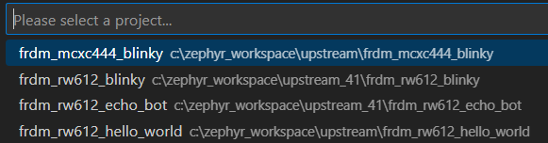
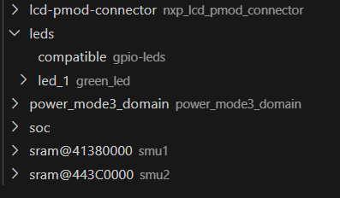
NXP MCUXPresso for Visual Studio Code
Navigating the platform’s devicetree

Slide 21
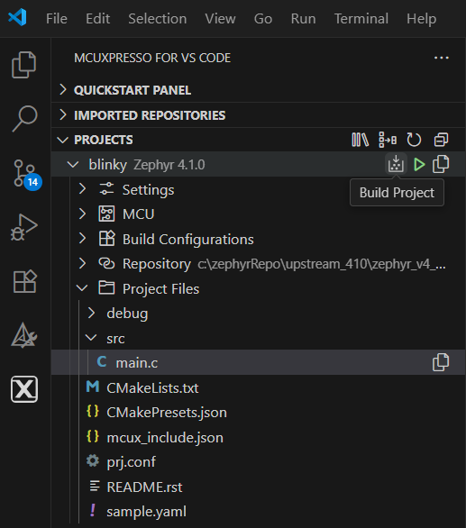
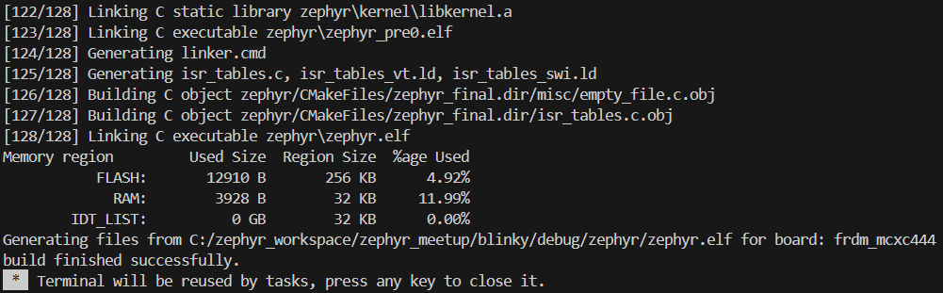
NXP MCUXPresso for Visual Studio Code
Build a project

Slide 22
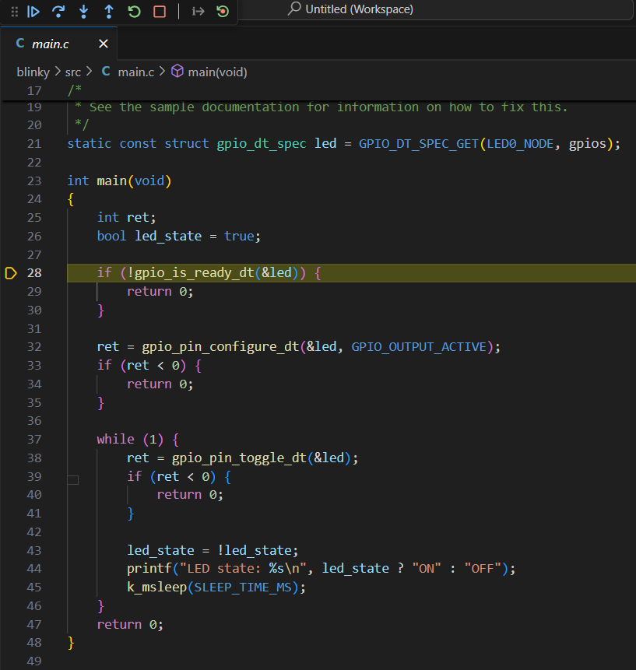
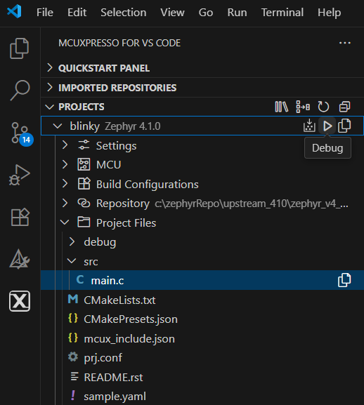
NXP MCUXPresso for Visual Studio Code
Flash and Debug a project

