Slide 1
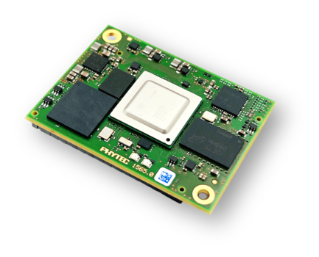



We embed your ideas
Zephyr and LVGL to build Industrial grade HMI Solutions

Slide 2

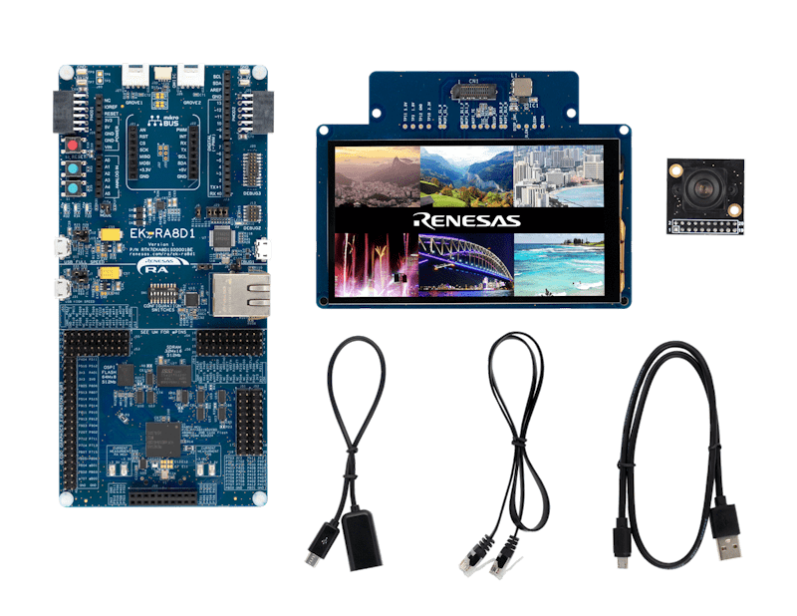
Open Discussion
About the Project :
This project focuses on porting a MIPI DSI LCD driver to the Zephyr RTOS for a Renesas platform. It emphasizes the use of the LVGL library for GUI development and aims for optimized performance in real-time applications.
Porting to Zephyr RTOS ensures better resource management, scalability, and real-time performance of the MIPI DSI driver.
This transition leverages Zephyr's modularity, allowing for versatile application development while maintaining low power consumption.
Unlocking stunning visuals with LVGL (Light and Versatile Graphics Library) enabling rich, interactive, and user-friendly GUIs.

Slide 3
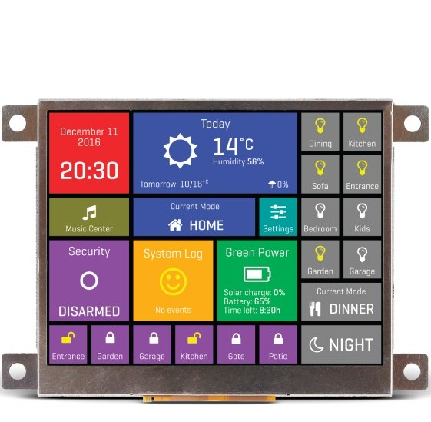
Open Discussion
Introduction to HMI
Human-Machine Interfaces (HMIs) are the front-end for machine control and monitoring.
Widely used in industrial systems: PLCs, robotics, and factory automation.
Industrial HMIs demand reliability, responsiveness, and longevity.
Challenges with Traditional HMIs
High cost and proprietary platforms.​
Complex integration with embedded hardware.​
Limited flexibility and scalability.

Slide 4
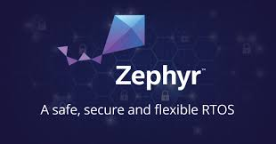
Open Discussion
What is Zephyr RTOS?
Open-source RTOS under the Linux Foundation.
Lightweight, secure, and scalable.
Supports over 450 boards, ARM, RISC-V, x86, etc.
Community backed with long-term support (LTS).

Slide 5
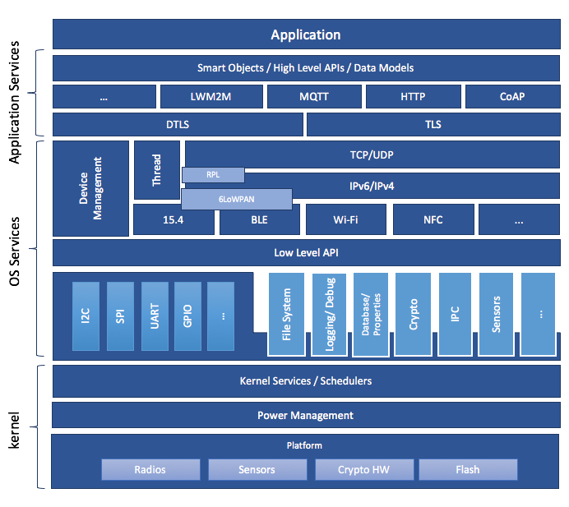
Open Discussion
Zephyr RTOS Architecture – Key Highlights
Application Services
Hosts user applications and logic.
Interfaces with high-level APIs and protocols (e.g., LWM2M, MQTT, HTTP, CoAP).
Secure communication supported via DTLS and TLS.
OS Services
Networking Stack: Supports 6LoWPAN, BLE, Thread, Wi-Fi, IEEE 802.15.4, and NFC.
Device Management: Integrated for remote and local management features.
Low-Level API Access: Direct access to system-level resources (I2C, SPI, UART, GPIO, File System, etc.).
Kernel
Provides core scheduling, power management, and thread handling.
Hardware abstraction through platform-specific components like Radios, Sensors, Crypto HW, and Flash.

Slide 6

Open Discussion
What is LVGL?
LVGL (Light and Versatile Graphics Library) is a free, open-source GUI library.
Designed for MCUs and embedded Linux.
Offers widgets: sliders, charts, gauges, buttons.
Optimized for performance and small memory footprint.

Slide 7
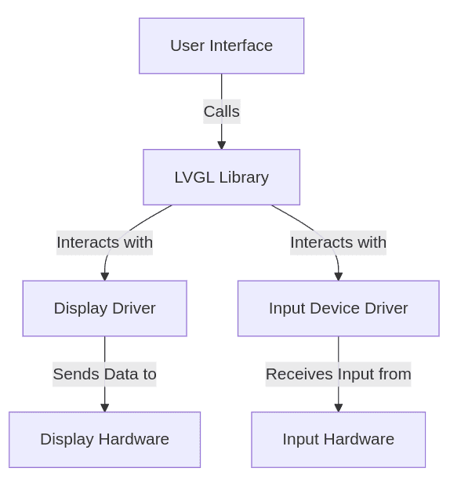
Open Discussion
LVGL Integration Architecture
User Interface (UI) logic initiates interaction by calling the LVGL Library.
LVGL Library acts as the core GUI engine, handling:
Drawing UI elements.
Processing input events.
Managing screen refreshes and animations.
LVGL interacts with two key drivers:
  Display Driver: Responsible for rendering UI by sending pixel/frame data to the display hardware.
  Input Device Driver: Captures touch/gesture events from input hardware (e.g., touchscreen, encoder).
Display Hardware receives the rendered UI data and presents it visually.
Input Hardware (like a touchscreen or keypad) detects user actions, which are routed back to LVGL via the input driver.
This modular separation allows easy portability across hardware platforms.

Slide 8
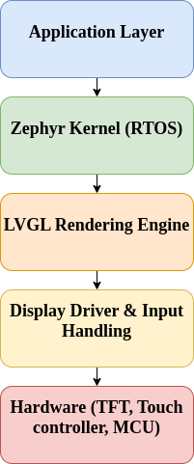
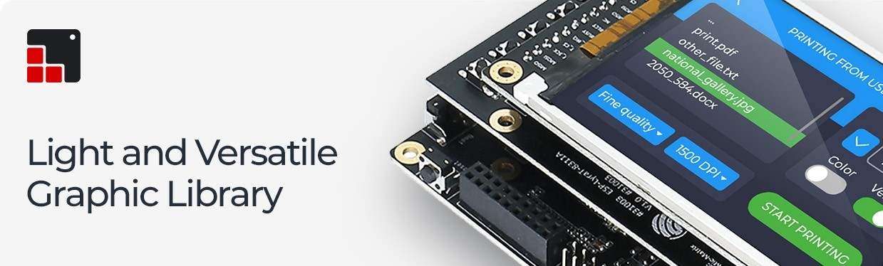
Open Discussion
Why Zephyr + LVGL is Powerful ?
Seamless task/thread management using Zephyr.
UI updates are non-blocking and real-time safe.
Easy integration of display and input drivers.
Power-efficient for industrial and wearable use cases.

Slide 9
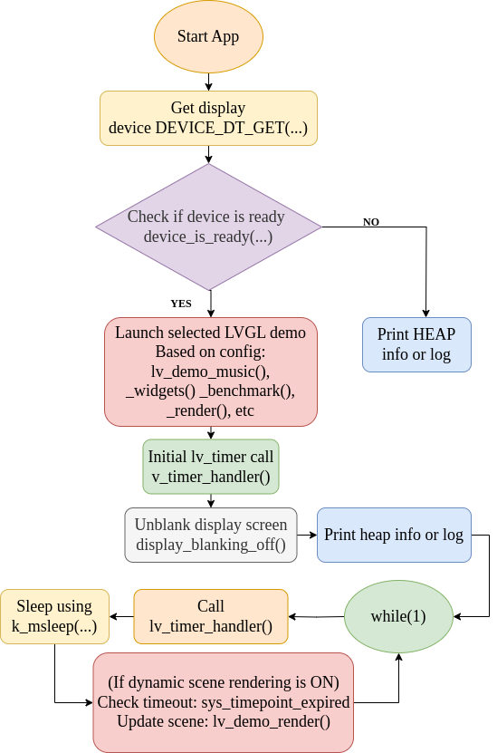
Open Discussion
Code Execution Flow – LVGL Zephyr App
App Start: Execution begins from main().
Display Initialization:
Retrieves display device using DEVICE_DT_GET(DT_CHOSEN(...)).
Device Ready Check:
Uses device_is_ready() to verify hardware status.
Demo Selection:
Launches demo based on config (lv_demo_music(), lv_demo_widgets(), etc.).
LVGL Setup:
Calls lv_timer_handler() to initialize internal LVGL timers.
Display Activation:
Unblanks screen via display_blanking_off().
Memory Info:
Optionally prints heap/malloc mode info (lvgl_print_heap_info()).
Main Loop (while(1)):
  Continuously calls lv_timer_handler().
  Sleeps via k_msleep(...) based on LVGL timing.
  (Optional) If scene rendering is dynamic:
    Checks for scene timeout using sys_timepoint_expired().
    Updates scene using lv_demo_render().

Slide 10
Open Discussion
MIPI_DSI Display Integration
project/
├── boards/
│ └── renesas_ra8d1/
│ └── ra8d1.dts
│ └── ra8d1_defconfig
├── drivers/
│ └── display/
│ └── display_ili9806e.c
│ └── Kconfig.ili9806e
│ └── CMakeLists.txt
├── dts/
│ └── bindings/
│ └── display/
│ └── ili9806e.yaml
├── samples/
│ └── lvgl_ili9806e/
│ ├── src/main.c
│ ├── boards/ra8d1.overlay
│ ├── prj.conf
│ └── CMakeLists.txt
1. Hardware & Device Tree Setup
Connect ILI9806E display via MIPI DSI to RA8D1 board
Configure device tree (DTS + overlay): define panel, reset GPIO, backlight PWM
2. Driver & Build Configuration
Add and enable custom display driver (display_ili9806e.c) in Zephyr
Update Kconfig and CMakeLists to include the driver
Enable LVGL and display configs in prj.conf
3. Application & LVGL Initialization
Initialize LVGL in main.c
Register display driver flush callback
Implement LVGL GUI loop with lv_timer_handler() for UI updates

Slide 11
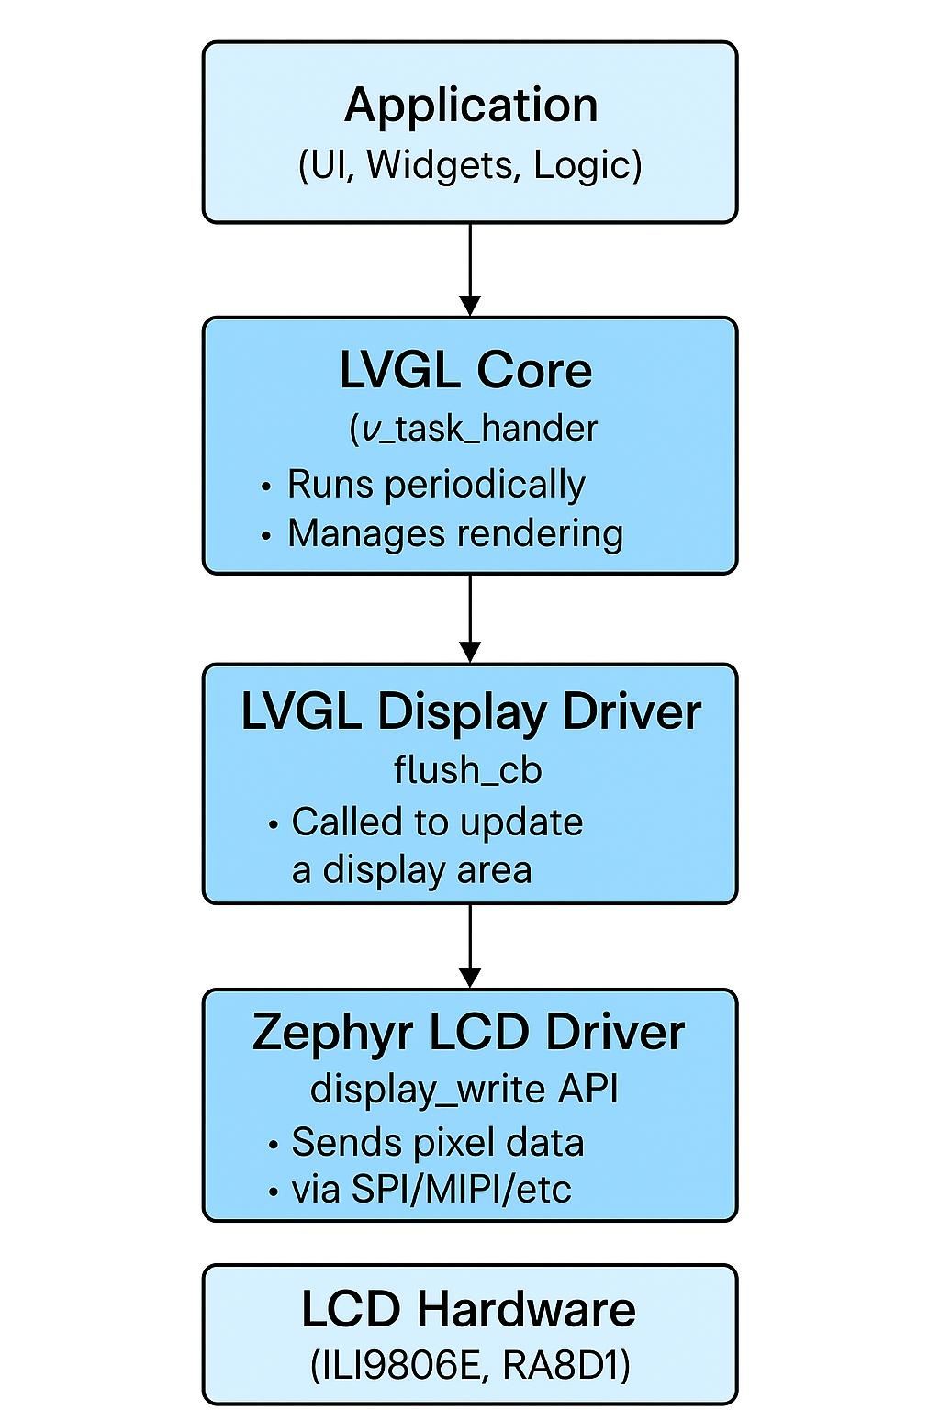
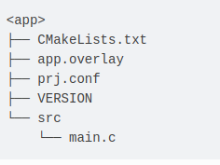
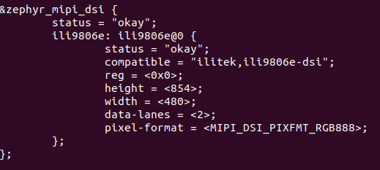
Open Discussion
MIPI Display Integration
API Function | Purpose
display_driver_init() | Initialize LCD hardware
display_write() | Write pixels to screen
display_blanking_on() | Turn display off
display_blanking_off() | Turn display on
display_set_brightness() | Adjust backlight brightness
display_get_capabilities() | Get display info
display_power_on() | Power on display

Slide 12
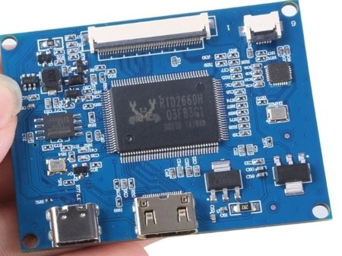
Open Discussion
Touchscreen Support with GT911
What is GT911?
Capacitive touch controller IC from Goodix.
Supports multi-touch with up to 5 points
I2C interface, often used with MIPI DSI panels
Why it matters in this project:
Added intuitive, real-time interaction to the HMI
Used Zephyr's I2C subsystem to communicate with GT911
Custom touch event handling integrated into LVGL input device driver

Slide 13
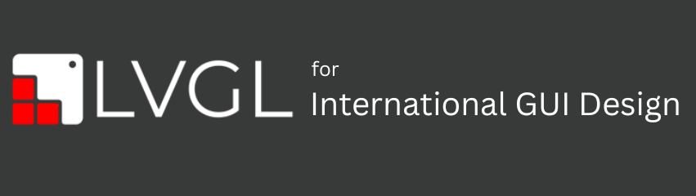
Open Discussion
LVGL Impact – Before vs After Integration
Aspect | Before (Legacy UI / No LVGL) | After (With LVGL on Zephyr)
UI Performance | Laggy transitions, static UI | Smooth 60 FPS animations
Dev Time | Manual rendering, low reusability | Reusable widgets, theme engine
Resource Usage | High CPU, memory constraints | ~40% lower CPU usage
Portability | Hard to adapt across products | Easily portable across SKUs
User Experience | Functional but basic | Modern, touch-friendly, intuitive

Slide 14
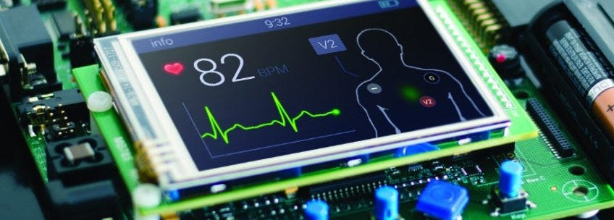
Open Discussion
Conclusion
"From hardware to user experience, this project showcases how Zephyr RTOS and LVGL together enable reliable, responsive, and modern industrial-grade HMIs on constrained embedded platforms."
Key Takeaways:
Zephyr RTOS brings real-time performance, modularity, and hardware abstraction.
LVGL empowers developers to create rich, intuitive UIs on MCUs without bloating resources.
GT911 touch integration completes the user experience, bringing interactivity to embedded displays.
The result: a scalable, low-power HMI stack ready for industrial, medical, and consumer-grade products.

