Slide 1


Embedded Controller Firmware Performance Profiler for Debugging
- Astha Chavda & Govinda Raj Sriharsha
Intel Corporation
Asthachavda
Astha Chavda

Slide 2
Agenda
Introduction of EC
Problem statement
Solution
Results
Conclusion & Future Plans
References

Slide 3
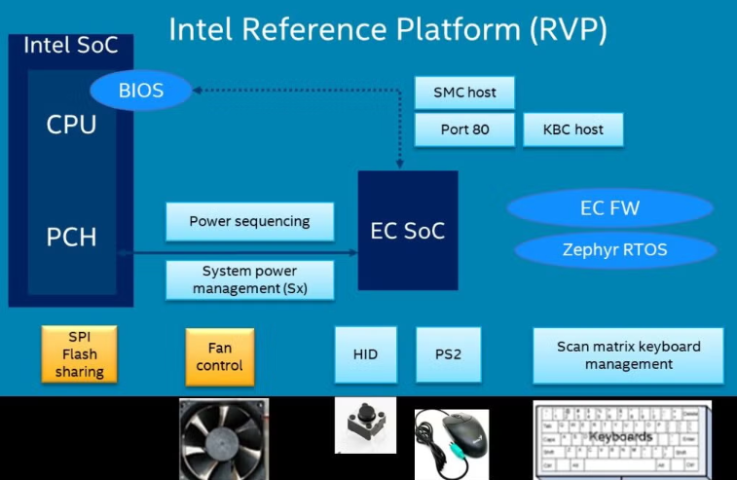
Introduction of Embedded Controller
The embedded controller (EC) is the heart of the mobile PC platform; it is the first device to receive power and the one which orchestrates sequencing all platform power in the correct order.
The EC is a 32-bit microcontroller integral to Intel’s Reference Validation Platform (RVP), tasked with essential hardware management functions such as power sequencing, battery, thermal, and Type-C policy & button management. Operating under stringent constraints of memory, CPU processing speed, and power consumption, optimizing the EC’s performance in terms of memory and CPU utilization is essential.
Source: https://intel.github.io/ecfw-zephyr/index.html

Slide 4
Problem Statement
EC is one of the critical platform Hardware managing platform Power sequencing, Battery, thermal sensors, CPU/GPU fan & USB TypeC policies.
EC operates under the limited memory, CPU speed and power budget.
Debugging EC performance defects requires real-time monitoring of code flow during firmware execution.
Current debug methodology requires external debug hardware/software tools on debug test stations and instrumentation in EC FW code.
Given that, EC performs many time critical platform HW management functionalities which requires real time responses, it’s critical that EC CPU’s performance in terms of memory/CPU utilization and power consumption are optimized.

Slide 5
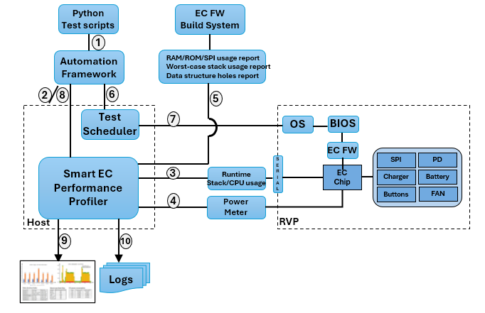
Solution
EC profiler is integrated in automation framework
Performs offline analysis on host machine.
Doesn't have dependency on special HW and instrumentation in platform and EC FW.
Updates the dashboard with below information:
Compile-time memory analysis:
RAM, flash and stack usage analysis.
Worst-case stack usage analysis.
Data structures holes.
Run-time stack and CPU usage analysis:
EC threads stack and CPU usage analysis.
EC power consumption in S0, CS, PG3, S4 and S5 power states.
Key benefits
Profiles data in dashboard which can be visualized by debug engineers to diagnose the failures.
Proactively identifies defects before escaping to customers saving debug, development & validation efforts.

Slide 6

Results
EC FW performance defects debug will become easier with the availability of this tool.
User can infer multiple metrics. Some critical ones are highlighted below.
RAM/flash metrics helps to have always check on usage.
Worst-case stack requirement helps managing stack memory efficiently.
Identifying data holes due to misalignment / bad programming can help optimize RAM memory usage.
Analyzer will flag warning when power numbers not met.
These indicators will help debug engineer to study CPU/ memory usage to know threads that active always/ waking frequently blocking entry to low power modes.

Slide 7
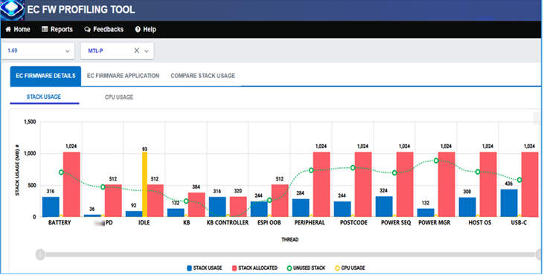
Results (Contd.)
EC profiler continuously collects EC FW threads run-time stack utilization traces.
When allocated stack memory not sufficient can lead to stack overflow thus not responding to host OS requests which can result in OS timeout leading to crash/ BSOD.
With efficient stack management, debug engineer can proactively identify these kind of defects before escaping to the production.
Notes:
Will remove CCG PD here

Slide 8
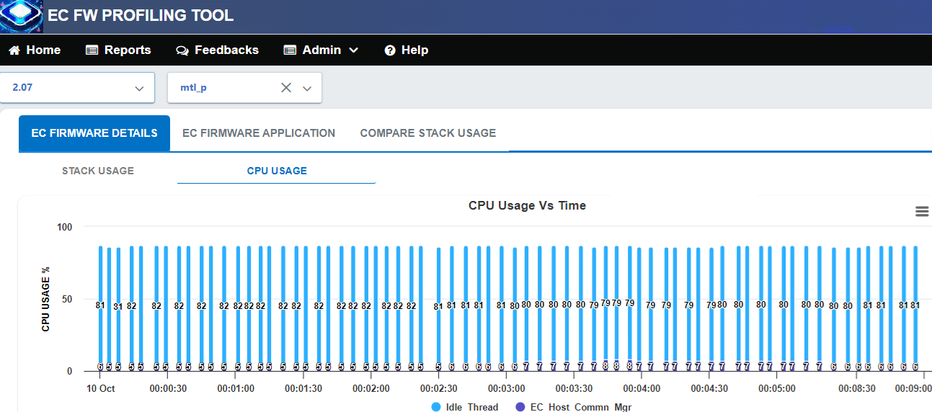
Results (Contd.)
EC profiler collects EC threads run-time CPU utilization traces.
To achieve EC KPIs, the idle thread should be active for most of the time. When idle thread becomes <X% (platform dependent) active, the tool will flag warning.
This indicator helps debug engineer to proactively diagnose the EC FW threads active/ waking frequently leading to high EC power consumption defects.

Slide 9
Conclusion & Future Plans
Currently, EC FW team requires multiple HW debugging tools and instrumentation to collect debug traces/information.
This profiling tool helps in capturing traces and help in predicting possible defects early in the SDLC process before bugs escaping to internal/external validation teams.
Tool helps in triaging defects faster without depending on external HW tools. Concept and methodology of profiling tool can be leveraged by other FW teams as-is who are using Zephyr RTOS.
The planned roadmap for the tool includes the following enhancements:
Automatic diagnostics of EC FW crash dump analysis.
Automatic analysis of the profiled data to identify and root-cause the failures.

Slide 10
References
Zephyr RTOS optimization tools: https://docs.zephyrproject.org/latest/develop/optimizations/tools.html
Zephyr RTOS thread analyzer: https://docs.zephyrproject.org/latest/services/debugging/thread-analyzer.html
Open EC source code: https://github.com/intel/ecfw-zephyr
Open EC Documentation: https://intel.github.io/ecfw-zephyr/index.html

Slide 12
Zephyr tools
Puncover Tool:
The puncover is the third-party tool supported by zephyr RTOS and which can be found at https://github.com/HBehrens/puncover. Once the EC application is built, it will launch a local web server which will allow you to open a web client and browse the files and view their ROM, RAM, and worst-case stack usage data.
Command (using west):
west build -c -p auto -b mec1501_mtl_p -- -DCONFIG_STACK_USAGE=y
west build -t puncover
Pahole Tool:
Poke-a-hole (pahole) is an object-file analysis tool to find the size of the data structures, and the holes caused due to aligning the data elements to the word-size of the CPU by the compiler.
Command (using west):
west build -c -p auto -b mec1501_mtl_p
west build -t pahole

