Slide 1
NXP Zephyr RTOS dev-ops
Hake huang / Suram Suram
March 2025

Slide 2
Zephyr Dev Ops Philosophy
Zephyr CI downstream
NXP Zephyr CI infrastructure

Slide 3
Zephyr Dev Ops Philosophy
Zephyr is based on community development.
  From day one, Zephyr has its Dev-ops founded, and operates in github actions
  Refer: https://www.youtube.com/results?search_query=zephyr+twister
  Zephyr dev ops includes several components:
  Tooling system, integrated in docker image
  SCM management by west system and github
  CI system in github actions
  Test runner system: twister
    Test plan and testcase in-tree and off-tree
    Test execution system
    Test log and report
  Test framework: ZTEST/GTEST/…
  Reporting system: Elastic search
  Build in test applications and automation context in tree
  NXP Zephyr is tightly adhered with Community system

Slide 4
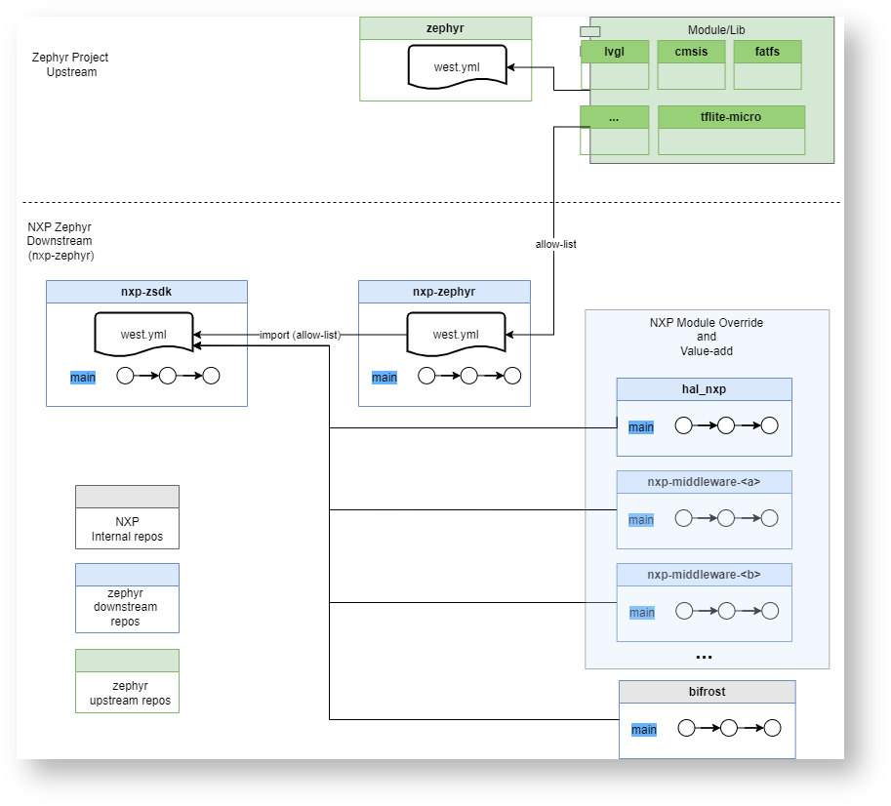
Zephyr downstream
https://confluence.sw.nxp.com/display/ZP/NXP+Zephyr+Downstream#NXPZephyrDownstream-WhatisaNXPZephyrDownstream

Slide 5
Zephyr downstream
  Zephyr devops includes several components:
  Tooling system, integrated in docker image <- reuse
  SCM management by west system and github <- biforst / bitbucket
  CI system in github actions <- elastic_jenkins
  Test runner system: twister <- reuse
  Test framework: ZTEST/GTEST/… <- reuse
  Reporting system: Elastic search <- reuse
  Build in test applications and automation context in tree <- leverage

Slide 6
NXP Zephyr CI diagram
Free
Paid Service
Limited Resources
github
allocate
Pull Request
K8S
allocate
Jenkins
Virtual Node 1
run machine
bitbucket
rpc
company network
rpc
Virtual Node ...
run machine

Slide 7
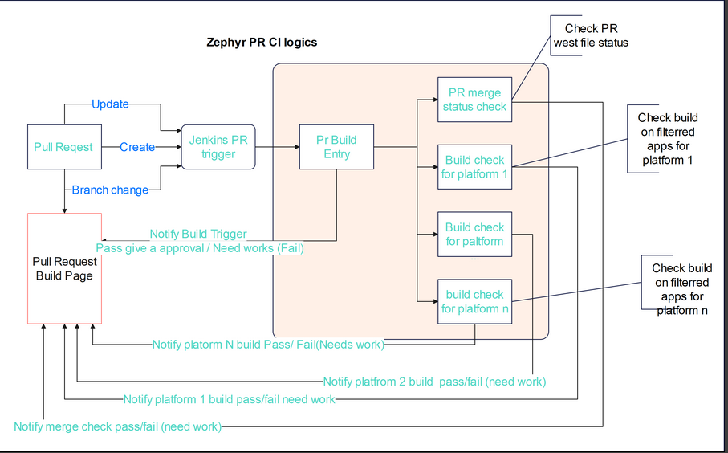
NXP Zephyr CI flow

Slide 8
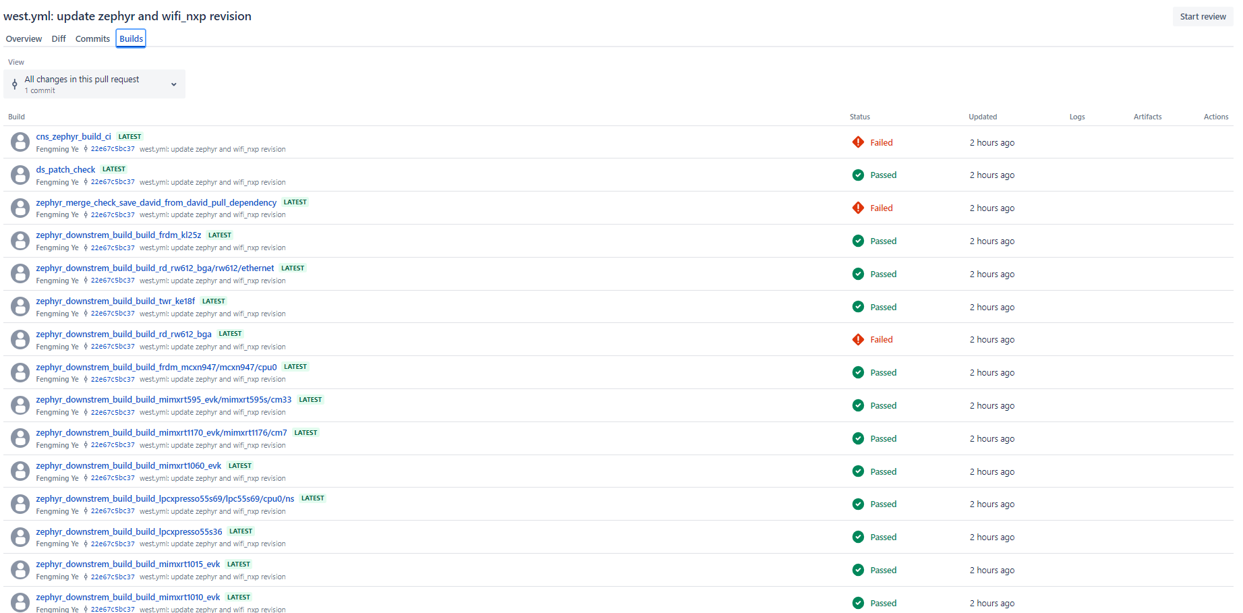
Example CI with BitbUcket

Slide 9
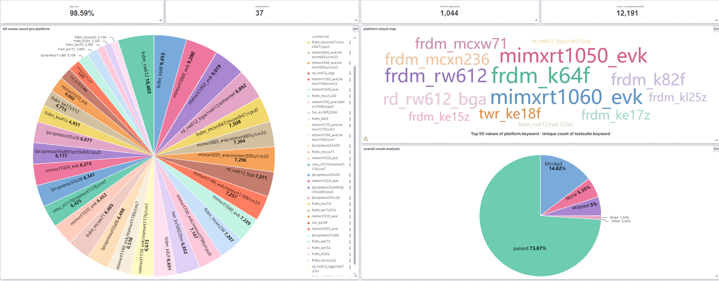
Example CI board testing report With Elastic-Search

Slide 10
Continues Integration
New Feature CI
colored: dynamic PR test request
Black: Fix cadency CI
NPI PR
Bug Fix
CI Check
CI Check
CI Check
Weekly CI
Weekly CI
Weely CI
Weekly CI

